Slide 1
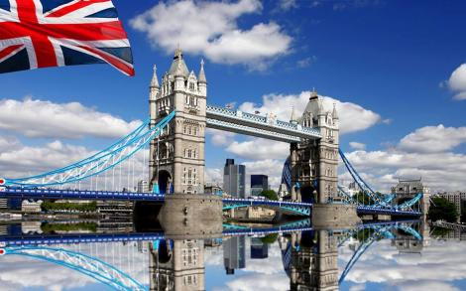
London
Prepared by:
Z.S. Tangatkan

Slide 2
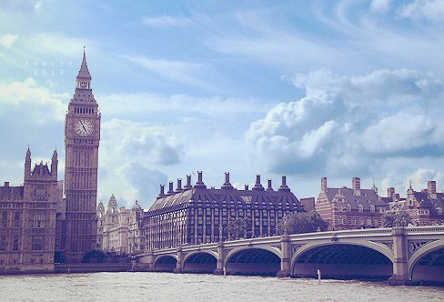
The 16th of January
London

Slide 3
Symbols of London
Trafalgar Square
Red telephone kiosk
Big Ben
London Eye
The Tower of London
Double-decker bus

Slide 4
Match the words:
Car
Train
Tram
Plane
Helicopter
Underground
Taxi
Balloon
Ship
Boat
Bus
Қайық
Трамвай
Машина
Ұшақ
Метро
Такси
Әуе шары
Пойыз
Кеме
Автобус
Тік ұшақ

Slide 5
Divide the means of transport into 3 groups:
Car, train, tram, yacht, plane, helicopter, underground, taxi, balloon, ship, bike, boat , bus, motorbike.
Land transport | Air transport | Water transport

Slide 6
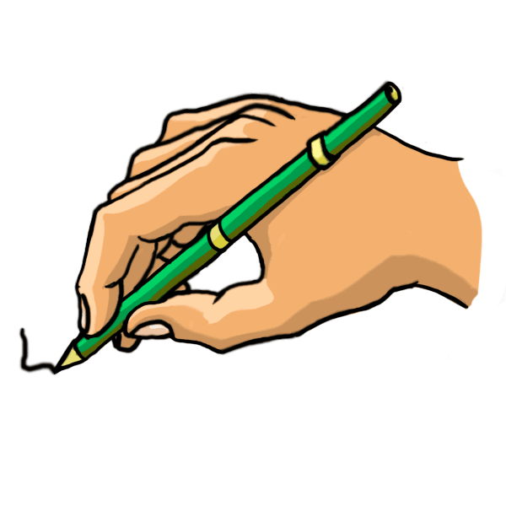
New words:
Double –decker- eкі қабатты автобус
Single-decker- бір қабатты автобус
Conductor- кондуктор
Inspector- инспектор
Upstairs- үстінгі қабат
Downstairs- астыңғы қабат
Queue- кезек
Ticket- билет
Coach- алыс жолға жүретін автобус

Slide 7
Work with the text:
Ex:1.p.119 read the text.
What is the difference between…
Conductor and conductress
Inspector and bus driver
Single-decker and double- decker
Bus and coach.

Slide 8
Work with books:
Ex: 2p. 119. Fill the gaps using the text:
The bus having only one floor is a single -decker.
The bus is a double-decker.
The person is a driver.
The man is a conductor.
The man is an inspector.

Slide 9
Work with books:
Ex: 2p. 119. Check your answers:
The bus having only one floor is a single –decker.
The bus having two floors is a double-decker.
The person who drives is a driver.
The man who takes money is a conductor.
The man who check your ticket is an inspector.

Slide 10
Listen to dialogue, find out order the sentences:
__ No, you’ll have to get off at the bank and take a 192.
1. Does this bus go to the station?
__ It’s the next stop but one.
__ Can you tell me where to get off?

Slide 11
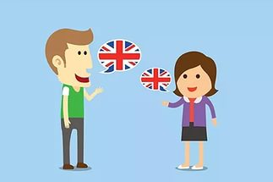
Check and act out the dialogue:
- Does this bus go to the station?
– No, you’ll have to get off at the bank and take a 192.
– Can you tell me where to get off?
– It’s the next stop but one.

Slide 12
Gerunds:
Answer the questions:
What is the Gerunds?
How we form the Gerunds?
When we use Gerunds?

Slide 13
Grammar:
Form the Gerunds:
E.g.: wait- waiting
Hurry, smoke, blow, carry, plan, try, grow, mix, die, close, rob, apply, offer, send, run, tie, cough.

Slide 14
  Form the gerund and put them:
  Paint, stay, close, be, play, go, lie, take, laugh, smoke
  He started____ early. His pictures are great.
  Do you mind___ the window?
  I hate ___ alone at home.
  I don’t mind ___ the monitor.
  Then he started ___ the piano.
  I dislike____ part in concerts.
  Do you enjoy _____ on the beach?
  Mum suggested ___ home early.
  I couldn’t help___ looking at her.
  I’m so happy. Dad stopped ____

Slide 15
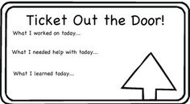
Reflection:

Slide 16
Giving home task:
Make up sentences using the gerunds.

Slide 17
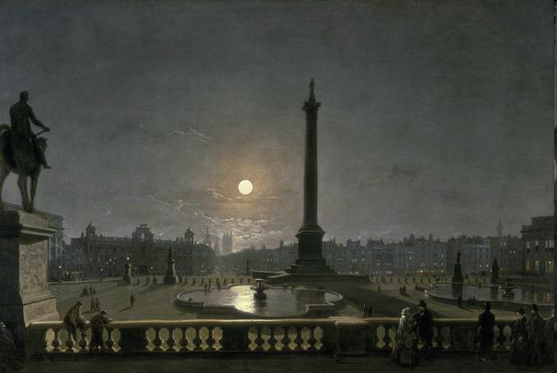
Trafalgar Square-the main square in London, which is situated in the center of London. It was situated in the 19 century.

Slide 18
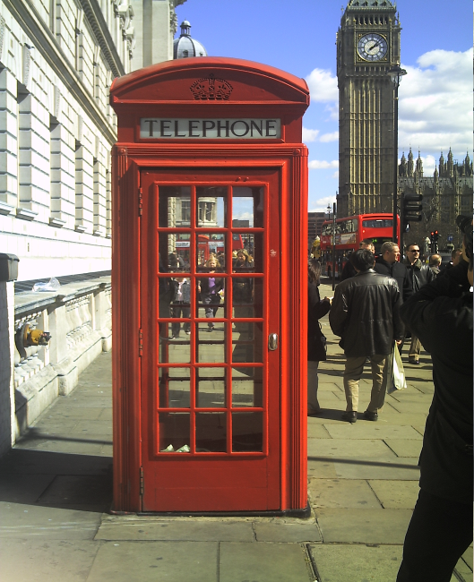
The red telephone box, a public telephone kiosk designed by Sir Giles Gilbert Scott. The colour red was chosen to make them easy to spot.

Slide 19
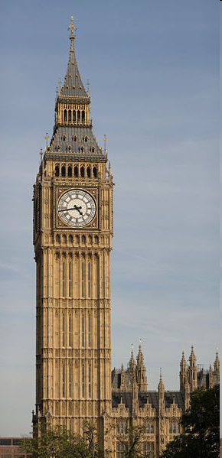
Another symbol of London is Big Ben. It was built in 1858 but the clock started to work only on the 21st of May in 1859.

Slide 20
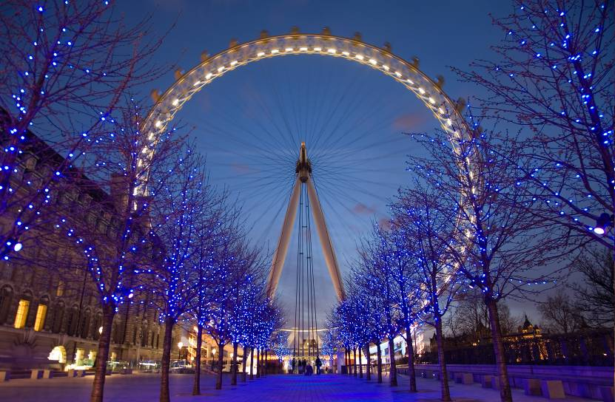
The London Eye is a 135-metre giant which is situated on the banks of the river Themes in London. It is the tallest Ferris wheel in Europe, and the most popular paid tourist attraction in the United Kingdom, visited by over 3.5 million people annually.

Slide 21
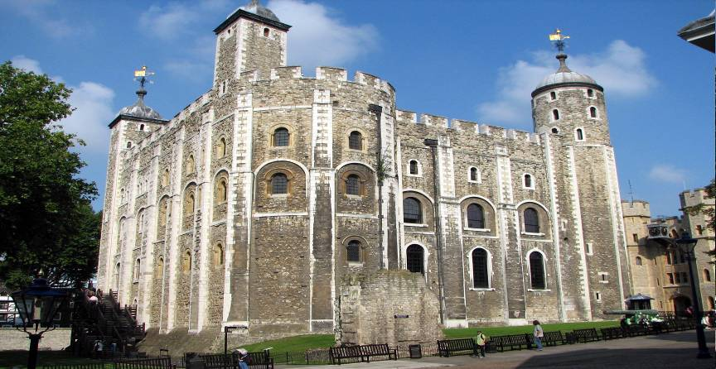
The Tower of London is a historic castle on the north bank of the River Thames in central
London, England. It was founded towards the end of 1066 as part of the Norman Conquest of England.

Slide 22
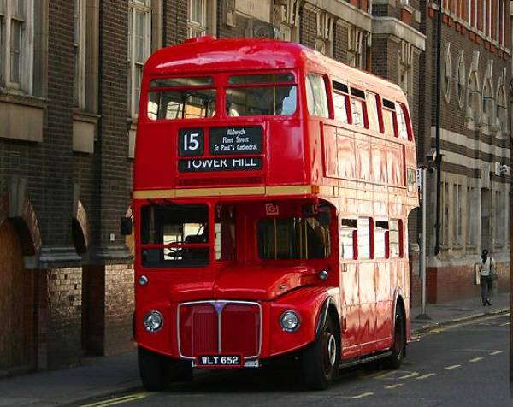
The first red Route master Double Decker Bus was unveiled on February 8, 1956. The buses were designed to replace the existing electrical trolleybuses. The double-decker buses were a collaborative effort between London Transport designer Douglas Scott, AEC and Park Royal engineers.

